Slide 1

Financial Risk Management
Spring 2016
Dr. Ehud Peleg
Value at Risk

Slide 2
Agenda
What is Value at Risk (VaR)?
Applications of VaR
Simple Examples
Expected Shortfall
Coherent Risk Measures
Aggregation Through Time
Choice of VaR Parameters

Slide 3
A Concise Single Measure
Summarizes multiple aspects of risk in a single number.
As opposed to measures like the Greeks and Duration that look at particular sensitivities.
It is easy to understand and communicate.
It asks the simple question: “How bad can things get in a given period of time?”

Slide 4
The VaR Statement
“We are α percent certain that we will not lose more than L dollars in time T.”
L is the VaR
T is the Time Horizon
α is the Confidence Level

Slide 5
Formal Definition of VaR
The VaR at confidence level, α, is the smallest number L, such that the probability that losses exceed L is no larger than 1-α.
Or,

Slide 6
Applications of VaR
VaR is the industry standard for reporting, both internally and externally.
It is part of most regulatory frameworks.
It is used for calculating Capital requirements – How big a cushion do we need to cover losses at a certain probability?
Calculations for internal purposes are usually called Economic Capital
Calculations based on regulatory specifications for reporting purposes are called Regulatory Capital.
It is used for setting limits, predominately on trading floors and portfolios.

Slide 7
Dell, Inc. 10-K
“Based on our foreign currency cash flow hedge instruments …, we estimate a maximum potential one-day loss in fair value of … $65 million, … using a Value-at-Risk (“VaR”) model. By using market implied rates and incorporating volatility and correlation among the currencies of a portfolio, the VaR model simulates 3,000 randomly generated market prices and calculates the difference between the fifth percentile and the average as the Value-at-Risk.”

Slide 8
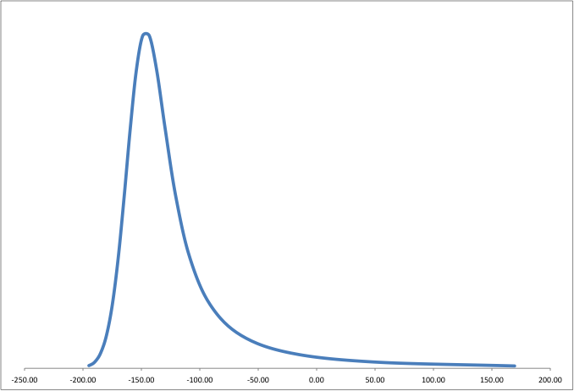
Expected and Unexpected Loss
X% Worst
Case Loss
Expected
Loss
VaR^{UL}
Unexpected Loss
Loss over time horizon

Slide 9
Normal Distribution Example
The daily gains on a portfolio of stocks are distributed normally with mean=0, and standard deviation =$5M
What is the 95% VaR?
Normsinv(0.05)*σ=-1.645×5 = -8.22mil
VaR_{95%} = $8.22mil

Slide 10
Normal Distribution Example (2)
The profit from a portfolio over six months is normally distributed with mean $2 million and standard deviation $10 million
The 1% point of the distribution of gains is 2−2.33×10 or − $21.3 million
The VaR for the portfolio with a six month time horizon and a 99% confidence level is $21.3M million.
If we look at Unexpected Losses:
Expected Loss = -$2M
Unexpected Loss VaR = $21.3M – (-$2M) = $23.3M

Slide 11
VaR Discrete Example
A one-year project has a 98% chance of leading to a gain of $2 million, a 1.5% chance of a loss of $4 million, and a 0.5% chance of a loss of $10 million
What is the VaR at a 99% confidence level?
$4 million
What if the confidence level is 99.9%?
$10 million
What if it is 99.5%?

Slide 12
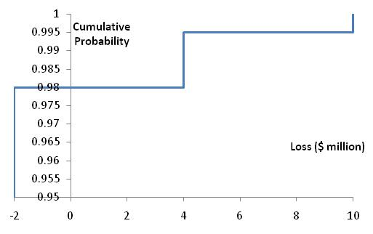
Cumulative Loss Distribution for Example
L | Prob. | Cum. Prob | P(Loss>L)
-2 | 98% | 98% | 2%
4 | 1.5% | 99.5% | 0.5%
10 | 0.5% | 100% | 0%

Slide 13
Expected Shortfall
VaR is the loss level that will not be exceeded with a specified probability, α.
Expected Shortfall is the average loss over the 1-α worst cases.
For continuous distributions: It is the mean loss given that the loss is greater or equal to the VaR level:
Also called: CVaR (Conditional VaR) or Tail Loss
Two portfolios with the same VaR can have very different expected shortfalls
Basel has recently moved to using ES rather than VaR

Slide 14
Distributions with the Same VaR but Different Expected Shortfalls
VaR
VaR

Slide 15
Example: Same VaR, Different ES
Suppose there are two possible states of the world:
A good state with probability = 0.8: Portfolio gains 100
A bad state with probability = 0.2: Portfolio loss is randomly drawn from U[50,100].
What is 90% VaR?
Let x be the VaR. It must be between 50 and 100.
The probability of loss being less than or equal to x is 0.9:
What is 90% Expected Shortfall?

Slide 16
Example: Same VaR, Different ES (2)
Suppose the two states are now:
A good state with probability = 0.8: Portfolio gains 100
A bad state with probability = 0.2: Portfolio loss is randomly drawn from U[0,150].
What is 90% VaR?
Let x be the VaR. It must be between 0 and 150.
The probability of loss being less than or equal to x is 0.9:
What is 90% Expected Shortfall?

Slide 17
Expected Shortfall - Normal Distribution
The daily losses on a portfolio of stocks are distributed normally with mean=0, and standard deviation of 5 million
What is the 95% VaR?
VaR = 1.645×5 = 8.22 million
What is the 95% Expected Shortfall?

Slide 18
Expected Shortfall - Normal Distribution
For the Mean Zero Normal Distribution, Expected Shortfall at a certain confidence level, is like VaR at some higher level
In our case:
95% Expected Shortfall = 98% VaR

Slide 19
Coherent Risk Measures
Monotonicity: If one portfolio always produces a worse outcome than another, its risk measure should be greater
Translation Invariance: If we add an amount of riskless asset paying K to a portfolio its risk measure should go down by K
Homogeneity: Multiplying the size of a portfolio by λ should result in the risk measure being multiplied by λ
Sub-additivity: The risk measures for two portfolios after they have been merged should be no greater than the sum of their risk measures before they were merged = benefit to diversification

Slide 20
VaR vs Expected Shortfall
VaR satisfies the first three conditions but not the fourth one
VaR is not coherent
Expected shortfall satisfies all four conditions.

Slide 21
Sub-Additivity −Example
Each of two independent projects has a probability 0.98 of a loss of $1 million and 0.02 probability of a loss of $10 million
What is the 97.5% VaR for each project? $1M
What is the 97.5% expected shortfall for each project?
Within the 2.5% worst results for the project:
Conditional Probability of $1M = (98-97.5)/2.5=0.5/2.5 Conditional Probability of 10mil = (100-98)/2.5=2/2.5
ES=(0.5/2.5)*1 + (2/2.5)*10 = 8.2

Slide 22
Sub-Additivity −Example (2)
What is the 97.5% VaR for the portfolio? 11
What is the 97.5% expected shortfall for the portfolio?
Conditional Prob. of 11 = (99.96-97.5)/2.5, Conditional Prob. of 20 = (100-99.96)/2.5
(2.46/2.5)*11 + (0.04/2.5)*20 = 11.144
Loss | Probability | Cum. Probability
1+1=2 | 0.98*0.98=96.04% | 96.04%
10+1=11 | 2*0.98*0.02=3.92% | 99.96%
10+10=20 | 0.02*0.02=0.04% | 100%

Slide 23
Sub-Additivity −Example (3)
This is an example of VaR not satisfying sub-additivity:
VaR for 1 project = 1, VaR for 2 projects = 11
VaR (2 projects)>2*VaR(1 project)
Expected Shortfall satisfies sub-additivity
ES for 1 project = 8.2, ES for 2 projects = 11.144
ES(2 projects)<2*ES(1 project)
ES always satisfies sub-additivity

Slide 24
Spectral Risk Measures
A spectral risk measure assigns weights to quantiles of the loss distribution
VaR assigns all weight to Xth quantile of the loss distribution
Expected shortfall assigns equal weight to all quantiles greater than the Xth quantile
For a coherent risk measure weights must be a non-decreasing function of the quantiles

Slide 25
Example: Simulation for Operational Risk VaR
Assume a bank has figured out that the probability of k events of fraud happening in a year is distributed according to the Poisson distribution:
The severity of the fraud is distributed lognormally.
What is the VaR-95% for annual loss due to fraud?

Slide 26
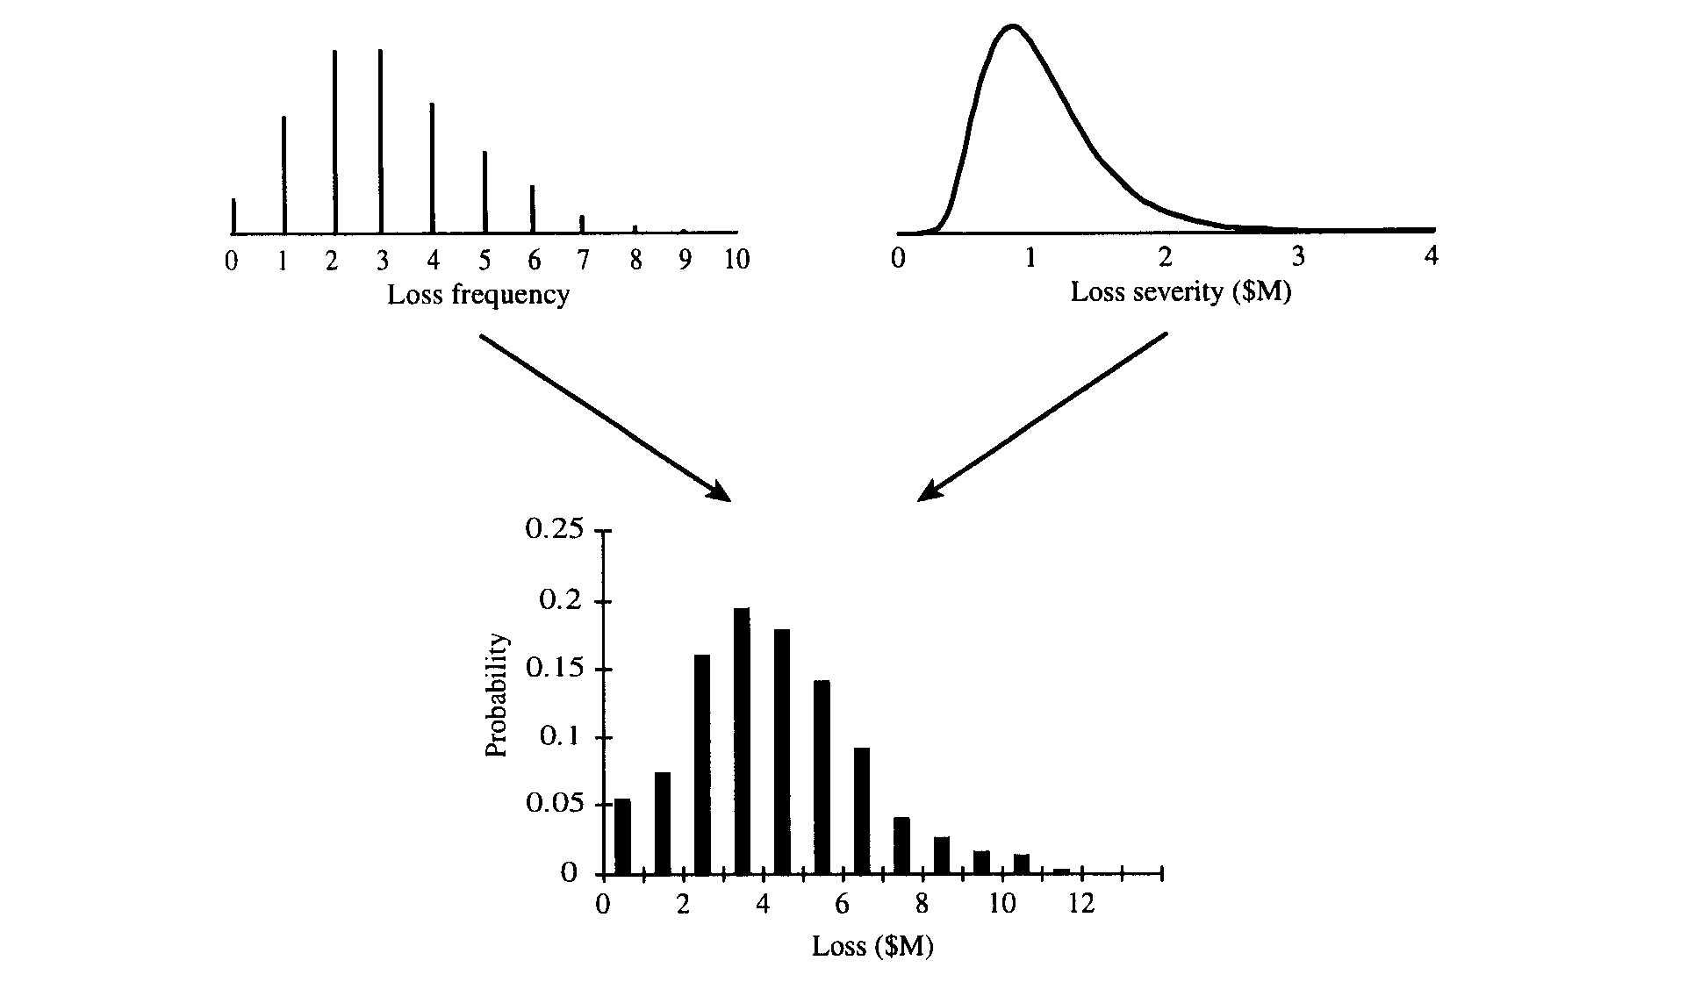
Using Monte Carlo to combine the Distributions

Slide 27
Monte Carlo Simulation
Create distribution of annual losses, by simulating many trials:
Sample from Poisson distribution to determine the number of loss events (=k)
Sample k times from the loss severity distribution to determine the loss severity for each loss event
Sum loss severities to determine total loss
Find the 95 percentile of the distribution

Slide 28
Credit VaR for Uncorrelated Loans
A bank has 100 loans of $15 million each. The probability of default (PD) of each loan is 2.5%. In case of default there is no recovery. Loan defaults are independent of each other.
What is the Expected Loss (EL) on the portfolio?
EL = 100*15*2.5% = $37.5

Slide 29
Credit VaR for Uncorrelated Loans (Example – Cont.)
What is the VaR_{96%} of the portfolio?
The probability of K loans defaulting is given by the Binomial Distribution
P(K loans default) = BINOMDIST(K, 100, 2.5%, 0)
P(# defaults ≤ K) = BINOMDIST(K, 100, 2.5%, 1)
The cumulative
Probability is given by:
There is 96% that 5 loans
or less will default.
Num Defaults | Cumulative Prob
0 | 0.08
1 | 0.28
2 | 0.54
3 | 0.76
4 | 0.89
5 | 0.96
6 | 0.99

Slide 30
Credit VaR for Uncorrelated Loans (Example – Cont.)
VaR_{96%} is therefore: 5*15 = $75M
The Unexpected Loss VaR_{96%} is equal to 75-37.5 = $37.5M
What if there was 60% recovery on each loan?
LGD = 40%
VaR-96% = 5*15*0.4 = $30M
But loan defaults in a portfolio are generally not independent … later in the course.

Slide 31
Aggregating VaR Over Time
The simplest assumption is that daily gains/losses are normally distributed and independent with mean zero
The T-day VaR equals times the one-day VaR
If there is positive autocorrelation the T-day VaR will be greater

Slide 32
Independence Assumption in VaR Calculations
When there is autocorrelation equal to ρ, instead of T-days variance being T times daily variance, the multiplier is:

Slide 33
Impact of Autocorrelation: Ratio of T-day VaR to 1-day VaR
 | T=1 | T=2 | T=5 | T=10 | T=50 | T=250
ρ=0 | 1.0 | 1.41 | 2.24 | 3.16 | 7.07 | 15.81
ρ=0.05 | 1.0 | 1.45 | 2.33 | 3.31 | 7.43 | 16.62
ρ=0.1 | 1.0 | 1.48 | 2.42 | 3.46 | 7.80 | 17.47
ρ=0.2 | 1.0 | 1.55 | 2.62 | 3.79 | 8.62 | 19.35

Slide 34
Choice of VaR Parameters
Time horizon:
Should depend on how quickly portfolio can be unwound.
Bank regulators use 1-day for market risk scaled by the square root of time to 10-days, and 1-year for credit/operational risk.
Confidence level:
Depends on objectives. Regulators use 99% for market risk and 99.9% for credit/operational risk.
A bank aiming to maintain a AA credit rating might use confidence levels as high as 99.98% for internal Economic Capital calculations.

Slide 36
Thanks

